Slide 1
Chapter 08: More Number Theory
Freshman Seminar
2022.01.18
Sumin Sohn

Slide 2
Contents
8.1 Prime Numbers
8.2 Fermat’s and Euler’s Theorems
8.4 The Chinese Remainder Theorem
8.5 Discrete Logarithms

Slide 3
8.1 Prime Numbers

Slide 4
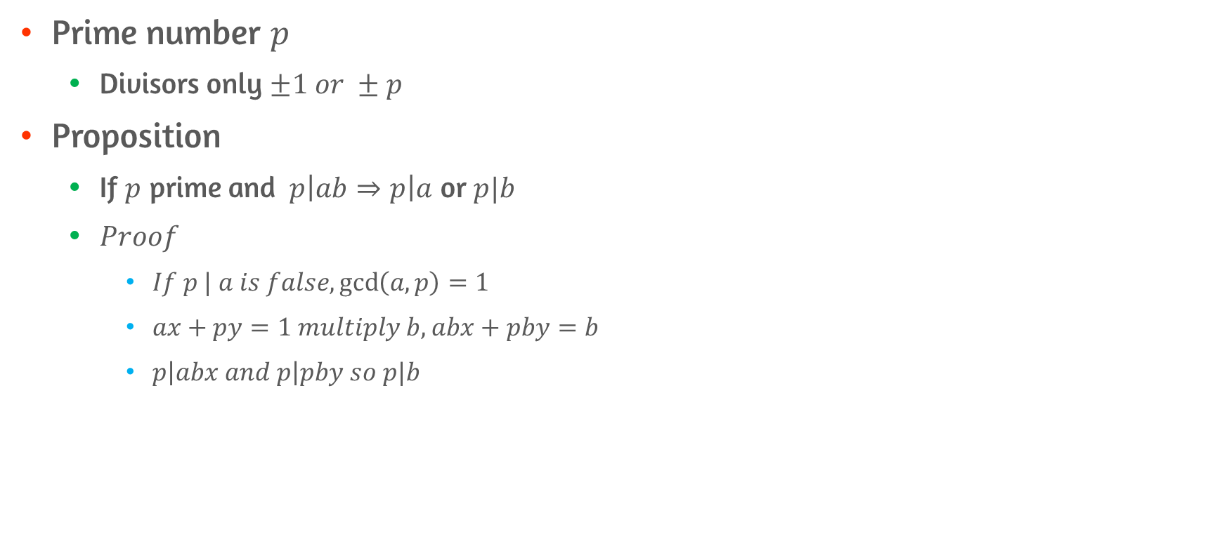
Theorems on Prime Number #1
Prime number $p$
Divisors only $±1 or ±p$
Proposition
If $p$ prime and $p\left|ab⇒p\right|a$ or $p|b$
$Proof$
$If p | a is false,\gcd\left(a,p\right)=1$
$ax+py=1 multiply b, abx+pby=b$
$p\left|abx and p\right|pby so p|b$

Slide 5
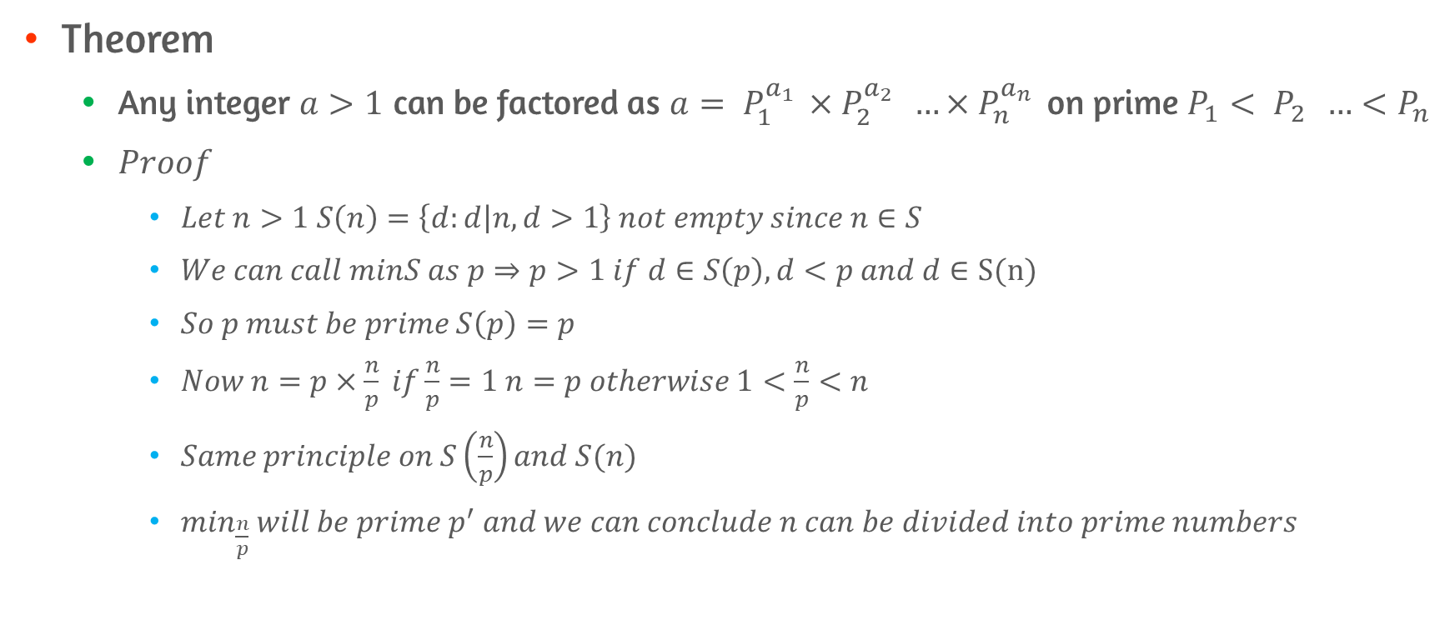
Theorems on Prime Number #2
Theorem
Any integer $a>1$ can be factored as $a= P_{1 }^{a_{1} }×P_{2 }^{a_{2} } …×P_{n}^{a_{n} }$ on prime $P_{1}< P_{2 } …<P_{n}$
$Proof$
$Let n>1 S\left(n\right)=\left\{d:d | n,d>1\right\} not empty since n∈S$
$We can call minS as p⇒p>1 if d∈S\left(p\right), d<p and d∈S(n)$
$So p must be prime S\left(p\right)=p$
$Now n=p×\frac{n}{p} if\frac{n}{p}=1 n=p otherwise 1<\frac{n}{p}<n$
$Same principle on S\left(\frac{n}{p}\right)and S(n)$
$\min_{\frac{n}{p}} will be prime p^{′} and we can conclude n can be divided into prime numbers$

Slide 6
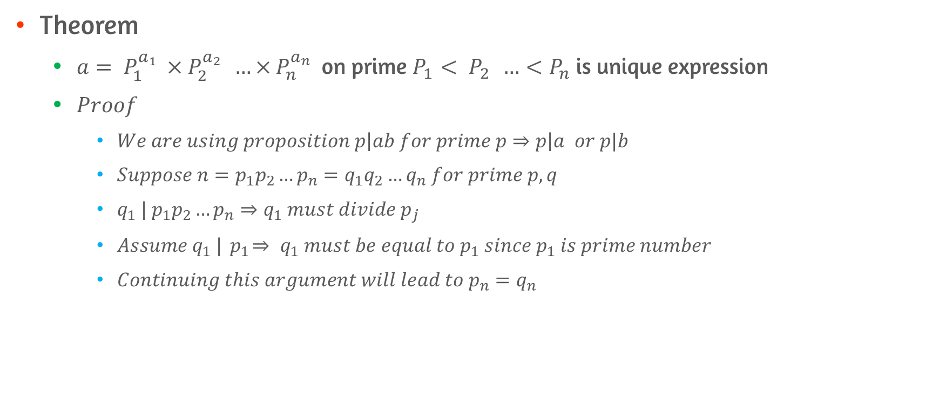
Theorems on Prime Number #3
Theorem
$a= P_{1 }^{a_{1} }×P_{2 }^{a_{2} } …×P_{n}^{a_{n} }$ on prime $P_{1}< P_{2 } …<P_{n}$ is unique expression
$Proof$
$We are using proposition p\left|ab for prime p⇒p\right|a or p|b$
$Suppose n=p_{1}p_{2}…p_{n}=q_{1}q_{2}…q_{n} for prime p,q$
$q_{1} |{ p}_{1}p_{2}…p_{n}⇒q_{1} must divide p_{j}$
$Assume{ q}_{1} |{ p}_{1}⇒{ q}_{1} must be equal to{ p}_{1} since{ p}_{1} is prime number$
$Continuing this argument will lead to p_{n}=q_{n}$

Slide 7
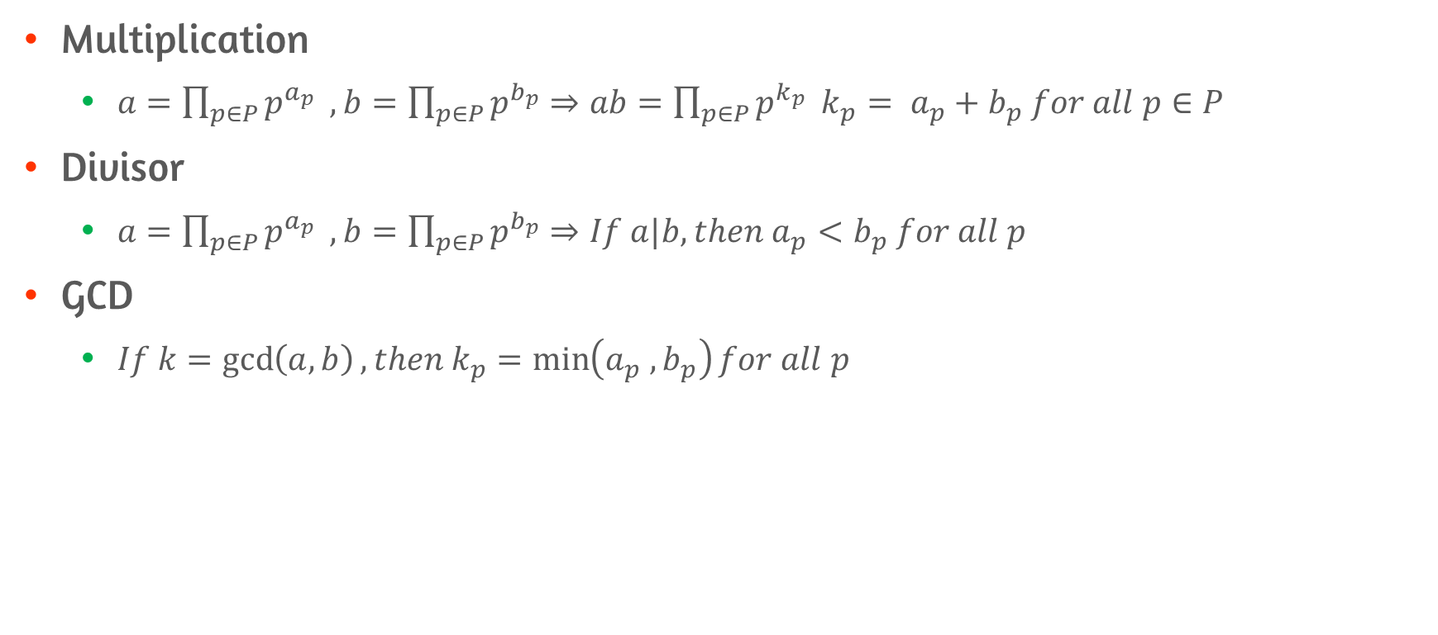
Arithmetic on Prime Number
Multiplication
$a=\prod_{p∈P}{p^{a_{p}}} , b=\prod_{p∈P}{p^{b_{p}}}⇒ab=\prod_{p∈P}{p^{k_{p}} }k_{p}= a_{p}+b_{p} for all p∈P$
Divisor
$a=\prod_{p∈P}{p^{a_{p}}} , b=\prod_{p∈P}{p^{b_{p}}}⇒If a|b, then a_{p}<b_{p} for all p$
GCD
$If k=\gcd\left(a,b\right), then k_{p}=\min\left(a_{p} , b_{p}\right)for all p$

Slide 8
8.2 Fermat’s and Euler’s Theorems

Slide 9
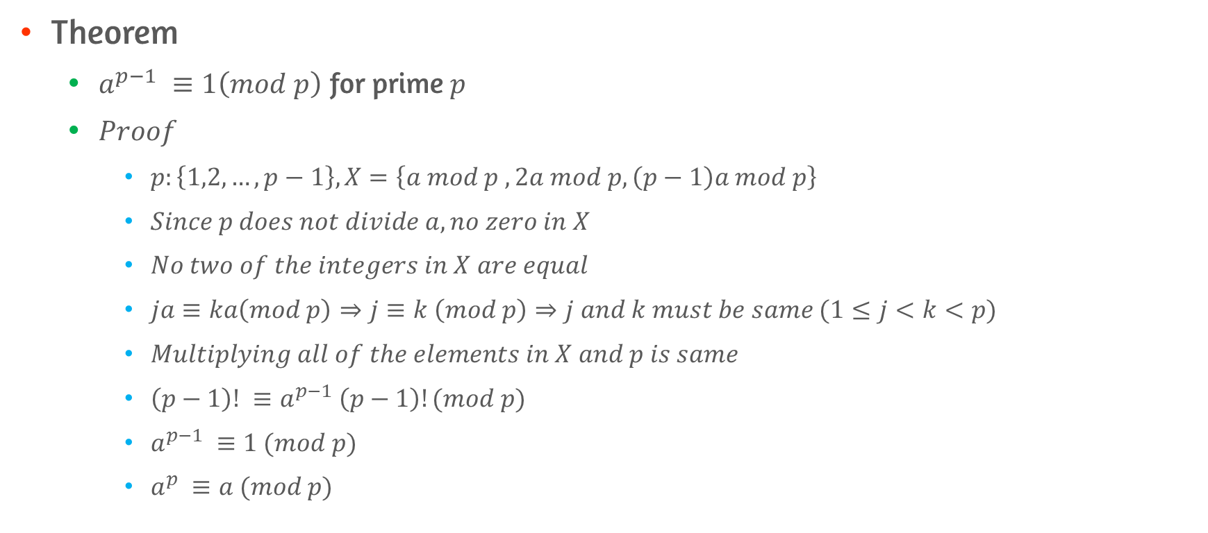
Fermat’s Theorem
Theorem
$a^{p−1} ≡1\left(mod p\right)$ for prime $p$
$Proof$
$p:\left\{1,2,…, p−1\right\}, X=\left\{a mod p , 2a mod p, \left(p−1\right)a mod p\right\}$
$Since p does not divide a, no zero in X$
$No two of the integers in X are equal$
$ja≡ka\left(mod p\right)⇒j≡k \left(mod p\right)⇒j and k must be same (1≤j<k<p)$
$Multiplying all of the elements in X and p is same$
$\left(p−1\right)! ≡a^{p−1} \left(p−1\right)!(mod p)$
$a^{p−1} ≡1 (mod p)$
$a^{p} ≡a (mod p)$

Slide 10
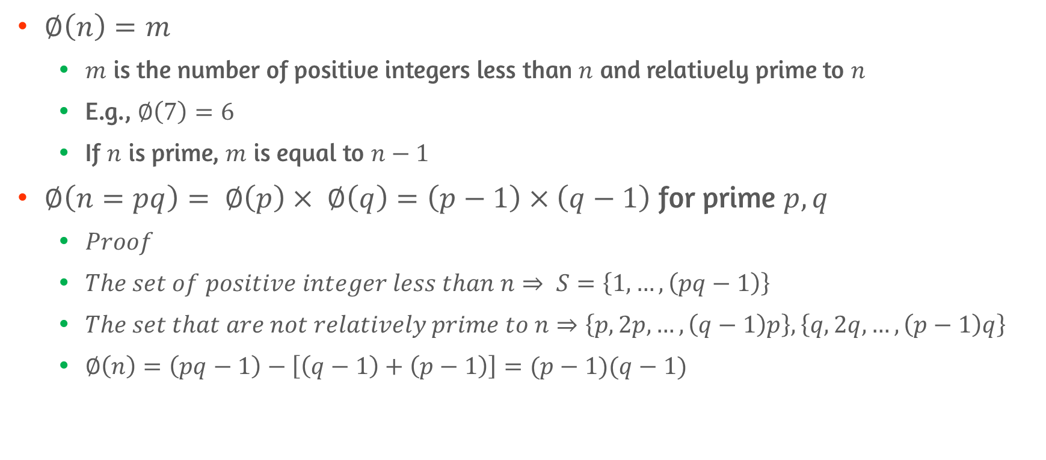
Euler’s Totient Function
$∅\left(n\right)=m$
$m$ is the number of positive integers less than $n$ and relatively prime to $n$
E.g., $∅\left(7\right)=6$
If $n$ is prime, $m$ is equal to $n−1$
$∅\left(n=pq\right)= ∅\left(p\right)× ∅\left(q\right)=\left(p−1\right)×\left(q−1\right)$ for prime $p, q$
$Proof$
$The set of positive integer less than n⇒ S=\left\{1,…,\left(pq−1\right)\right\}$
$The set that are not relatively prime to n⇒\left\{p,2p,…,\left(q−1\right)p\right\}, \left\{q,2q,…,\left(p−1\right)q\right\}$
$∅\left(n\right)=\left(pq−1\right)−\left[\left(q−1\right)+\left(p−1\right)\right]=(p−1)(q−1)$

Slide 11
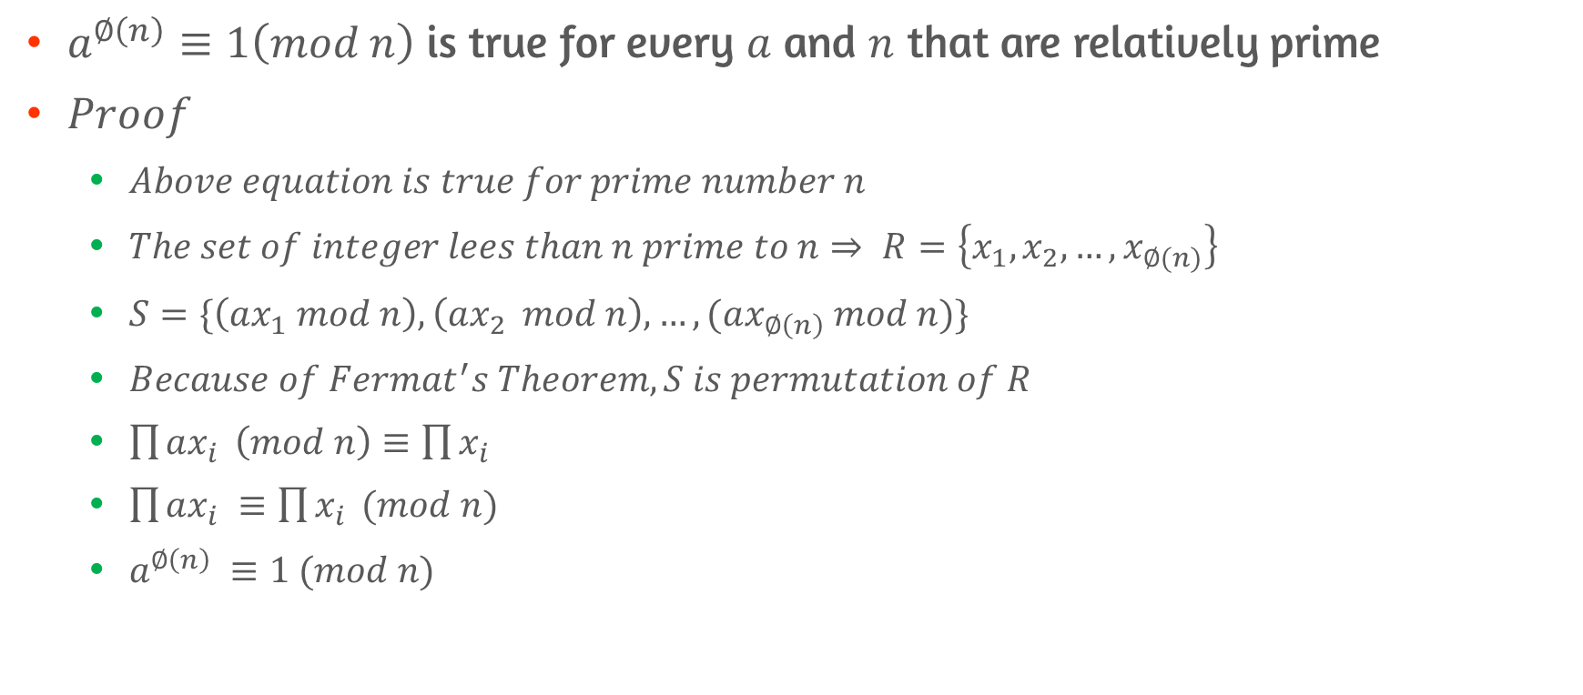
Euler’s Theorem
$a^{∅\left(n\right)}≡1\left(mod n\right)$ is true for every $a$ and $n$ that are relatively prime
$Proof$
$Above equation is true for prime number n$
$The set of integer lees than n prime to n⇒ R=\left\{x_{1},x_{2}, …,x_{∅(n)}\right\}$
$S=\{\left(ax_{1} mod n\right), \left(ax_{2 } mod n\right), …,(ax_{∅\left(n\right)} mod n)\}$
$Because of Fermat^{′}s Theorem, S is permutation of R$
$\prod{ax_{i}} \left(mod n\right)≡\prod{x_{i}}$
$\prod{ax_{i}} ≡\prod{x_{i}} (mod n)$
$a^{∅\left(n\right)} ≡1 (mod n)$

Slide 12
8.4 The Chinese Remainder Theorem

Slide 13
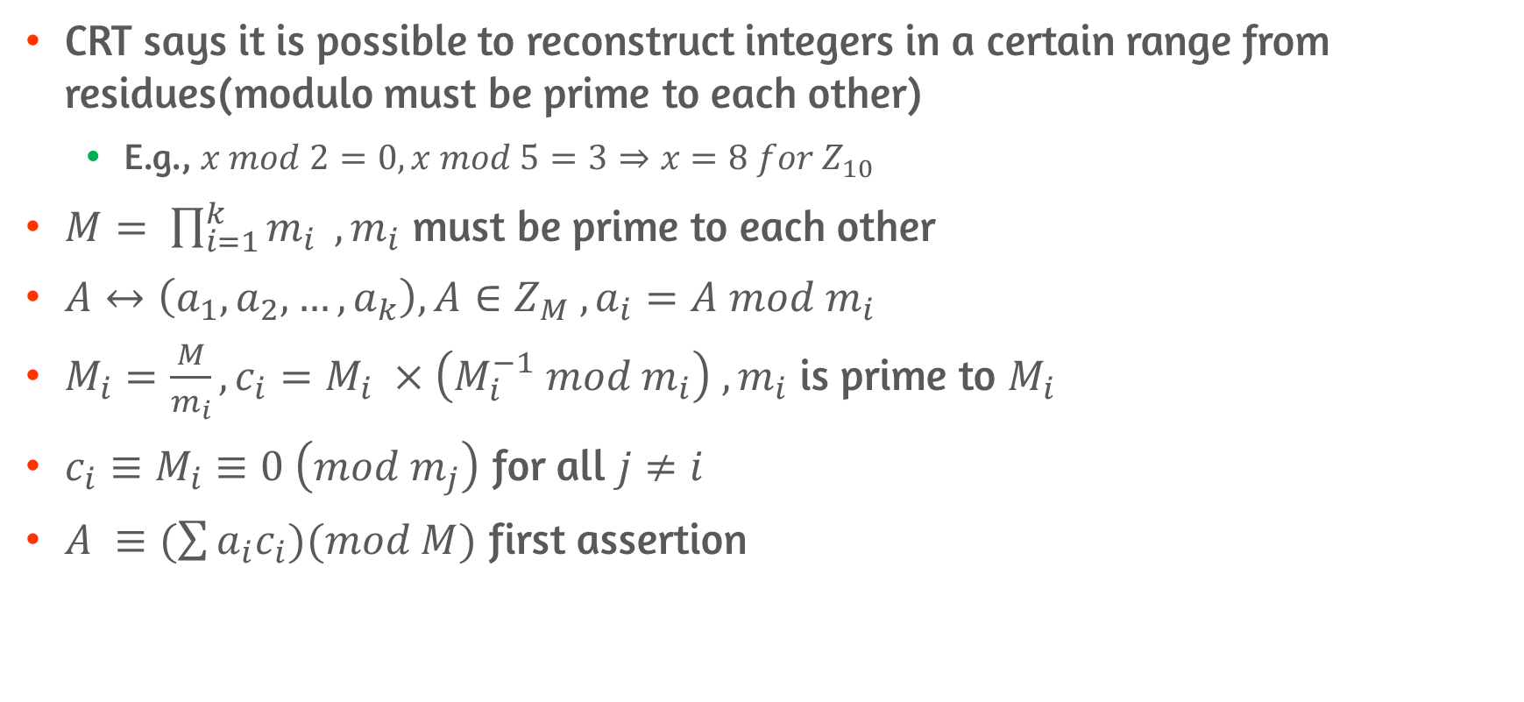
First Assertion
CRT says it is possible to reconstruct integers in a certain range from residues(modulo must be prime to each other)
E.g., $x mod 2=0, x mod 5=3⇒x=8 for Z_{10}$
$M= \prod_{i=1}^{k}{m_{i}} , m_{i}$ must be prime to each other
$A↔\left(a_{1},a_{2},…,a_{k}\right), A∈Z_{M} , a_{i}=A mod m_{i}$
$M_{i}=\frac{M}{m_{i}}, c_{i}=M_{i} ×\left(M_{i}^{−1} mod m_{i}\right) , m_{i}$ is prime to $M_{i}$
$c_{i}≡M_{i}≡0 \left(mod m_{j}\right)$ for all $j≠i$
$A ≡(\sum{a_{i}c_{i})(mod M)}$ first assertion

Slide 14
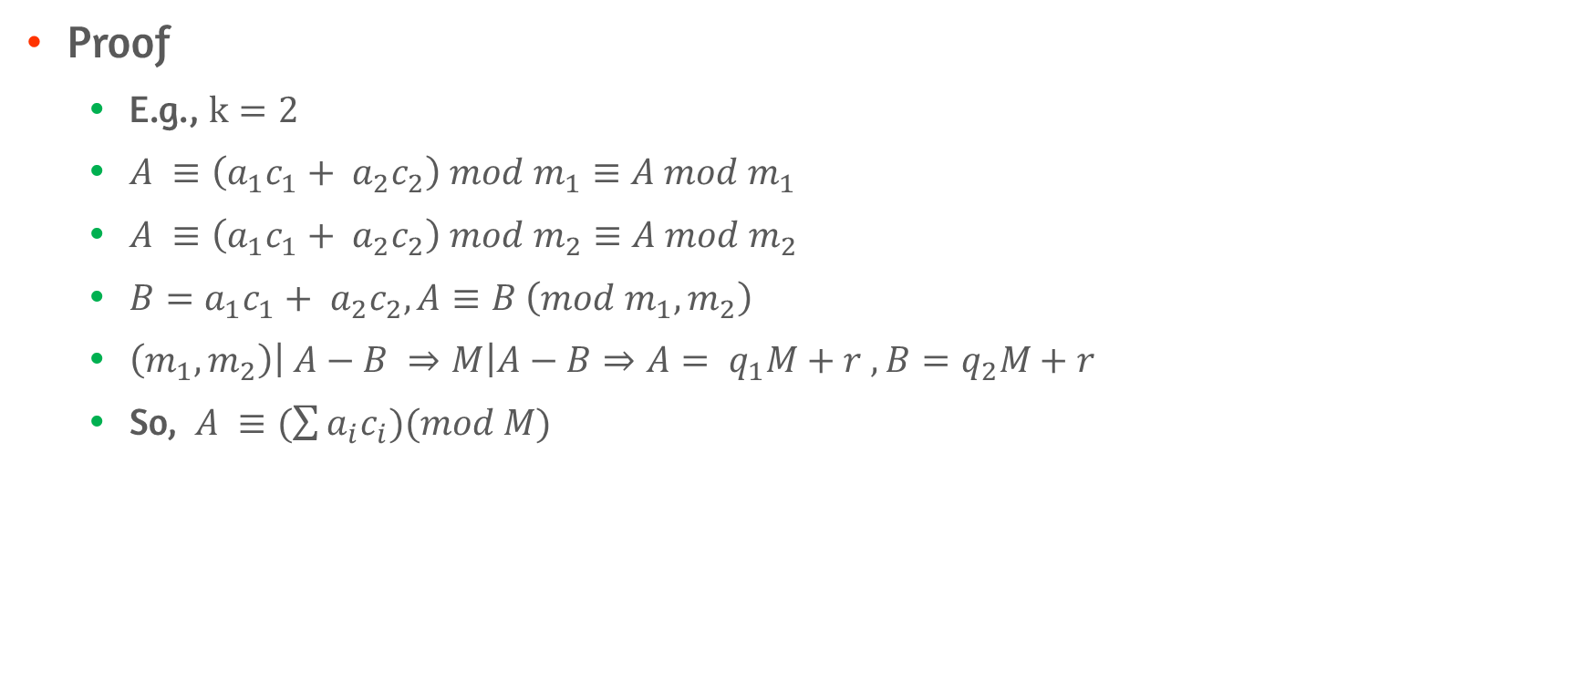
First Assertion Proof
Proof
E.g., $k=2$
$A ≡\left(a_{1}c_{1}+ a_{2}c_{2}\right) mod m_{1}≡A mod m_{1}$
$A ≡\left(a_{1}c_{1}+ a_{2}c_{2}\right) mod m_{2}≡A mod m_{2}$
$B=a_{1}c_{1}+ a_{2}c_{2}, A≡B \left(mod m_{1},m_{2}\right)$
$\left(m_{1},m_{2}\right)\left| A−B ⇒M\right|A−B⇒A= q_{1}M+r ,B=q_{2}M+r$
So, $A ≡(\sum{a_{i}c_{i})(mod M)}$

Slide 15
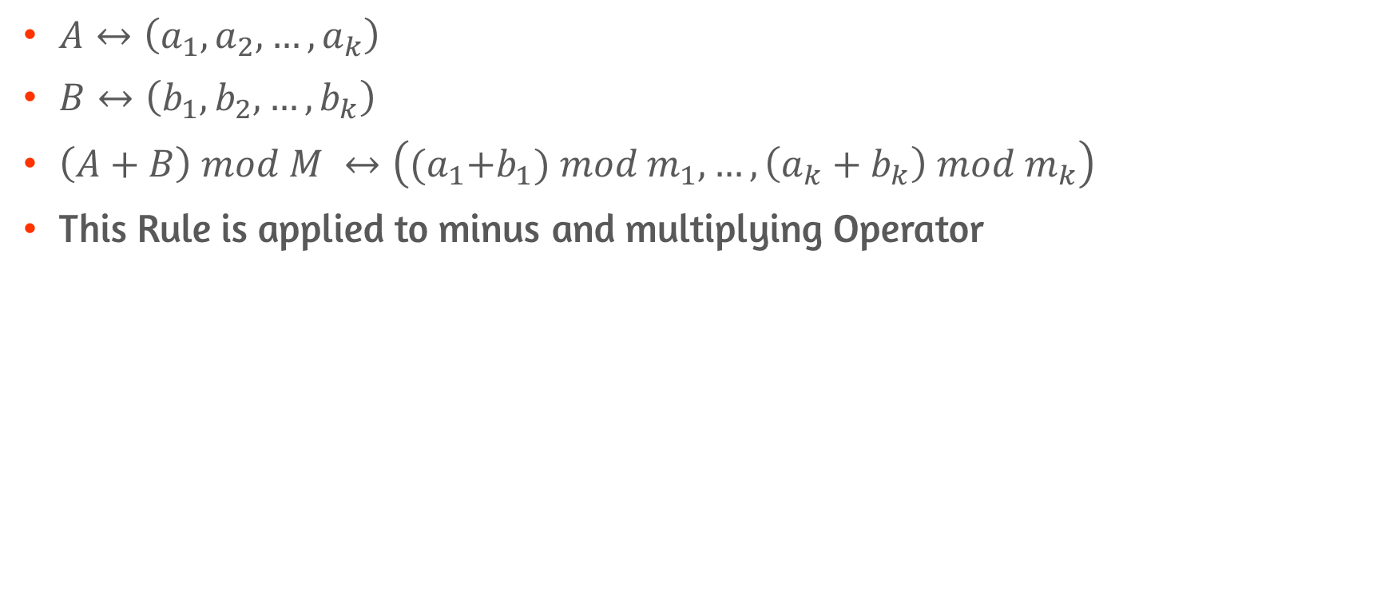
Second Assertion
$A↔\left(a_{1},a_{2},…,a_{k}\right)$
$B↔\left(b_{1},b_{2},…,b_{k}\right)$
$\left(A+B\right) mod M ↔\left({(a}_{1}+b_{1}) mod m_{1}, …,\left(a_{k}+b_{k}\right) mod m_{k}\right)$
This Rule is applied to minus and multiplying Operator

Slide 16
8.5 Discrete Logarithms

Slide 17
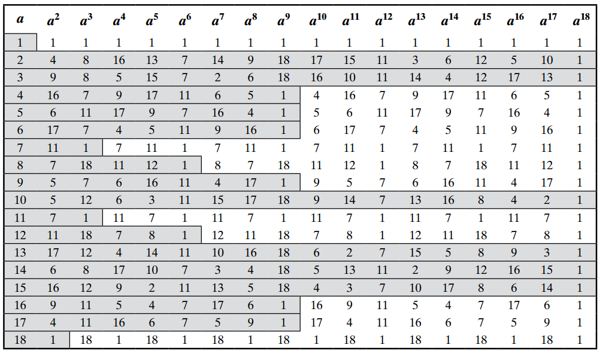
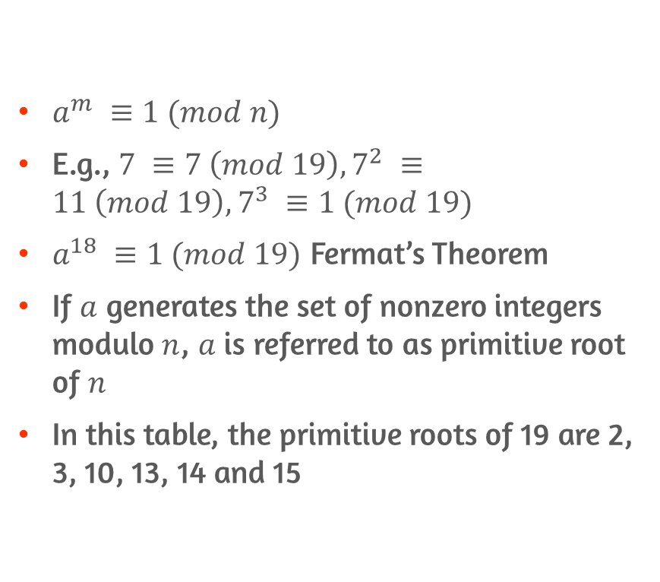
The Powers of an Integer, Modulo n
$a^{m} ≡1 (mod n)$
E.g., $7 ≡7 \left(mod 19\right), 7^{2} ≡11 \left(mod 19\right), 7^{3} ≡1 (mod 19)$
$a^{18} ≡1 (mod 19)$ Fermat’s Theorem
If $a$ generates the set of nonzero integers modulo $n$, $a$ is referred to as primitive root of $n$
In this table, the primitive roots of 19 are 2, 3, 10, 13, 14 and 15

Slide 18
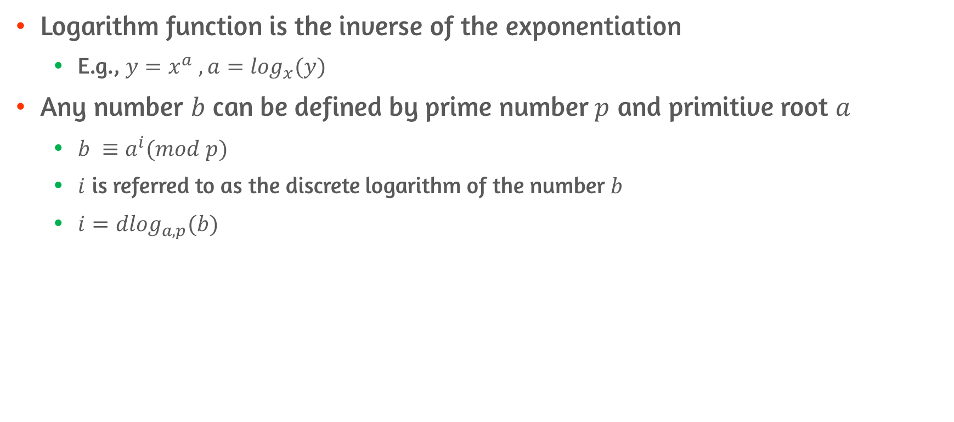
Logarithms for Modular Arithmetic #1
Logarithm function is the inverse of the exponentiation
E.g., $y=x^{a} , a=\log_{x}(y)$
Any number $b$ can be defined by prime number$p$ and primitive root $a$
$b ≡a^{i}(mod p)$
$i$ is referred to as the discrete logarithm of the number $b$
$i={dlog}_{a,p}(b)$

Slide 19
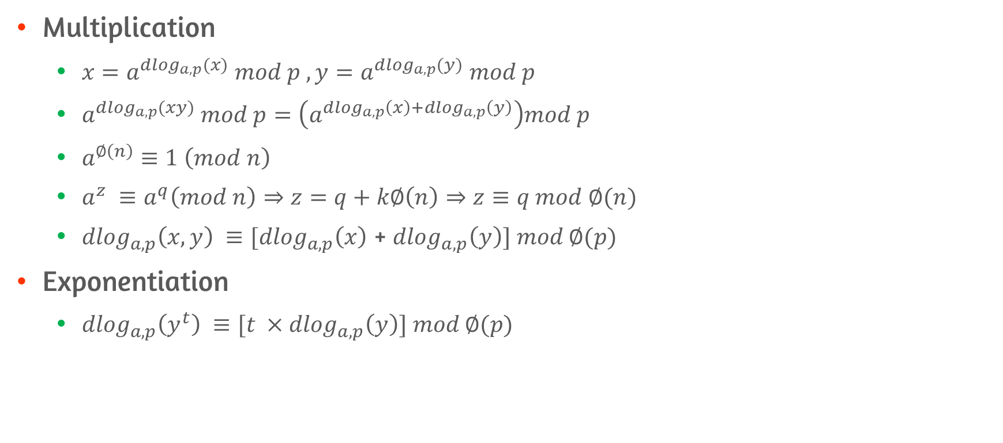
Logarithms for Modular Arithmetic #2
Multiplication
$x=a^{{dlog}_{a,p}(x)} mod p , y=a^{{dlog}_{a,p}(y)} mod p$
$a^{{dlog}_{a,p}(xy)} mod p=\left(a^{{dlog}_{a,p}\left(x\right)+{dlog}_{a,p}\left(y\right)}\right)mod p$
$a^{∅\left(n\right)}≡1 \left(mod n\right)$
$a^{z} ≡a^{q}\left(mod n\right)⇒z=q+k∅\left(n\right)⇒z≡q mod ∅(n)$
${dlog}_{a,p}\left(x,y\right) ≡[{dlog}_{a,p}\left(x\right)$ + ${dlog}_{a,p}\left(y\right)] mod ∅(p)$
Exponentiation
${dlog}_{a,p}\left(y^{t}\right) ≡[t { ×dlog}_{a,p}\left(y\right)] mod ∅(p)$

Slide 20
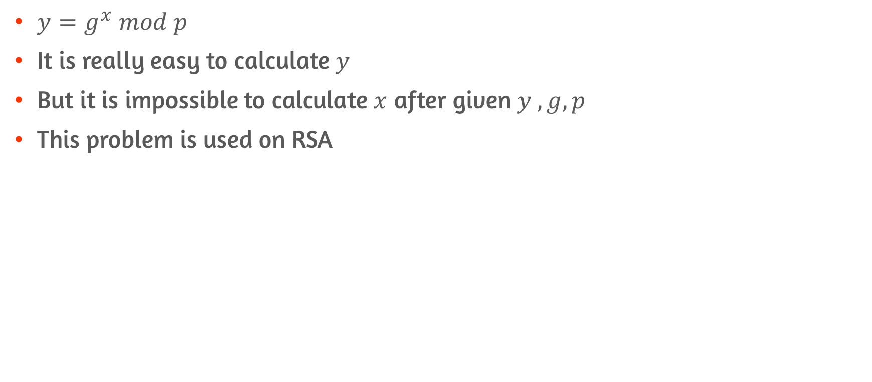
Discrete Logarithm Problem
$y=g^{x} mod p$
It is really easy to calculate $y$
But it is impossible to calculate $x$ after given $y , g, p$
This problem is used on RSA

Slide 21
Conclusion
Understand the key concepts relating to prime numbers
Understand Fermat’s theorem and Euler’s theorem
Define Euler’s totient function
Explain the Chinese remainder theorem
Define discrete logarithms

